Slide 1
Group 11
Disease Solutions
Michael Wang, Karuna Srivastava, Julia Monti,
Richard Amayo, Mrunmayi Dandekar

Slide 2
Objective
To create an automated process that simulates disease spread throughout the population of West Lafayette and Lafayette.
The solution aids public policy officials in devising flexible and effective policy strategies to mitigate the spread of pandemic disease.
Culmination of the following tasks:
Population Simulation
Database Design
Disease Spread Simulation
Policy Optimization

Slide 3
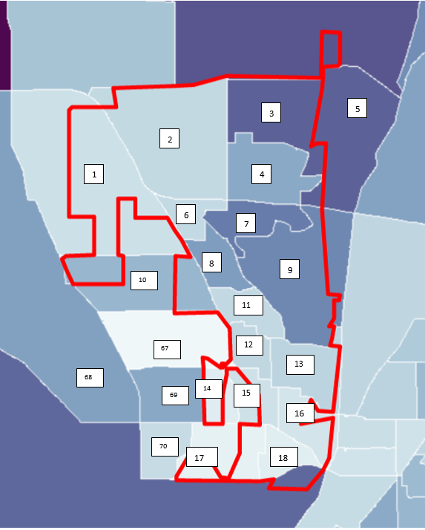
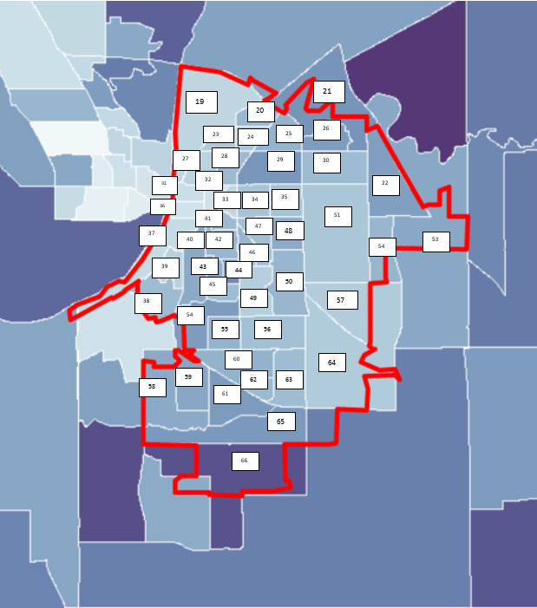
Population Simulation
Based on region-by-region statistics :
West Lafayette
Lafayette

Slide 4
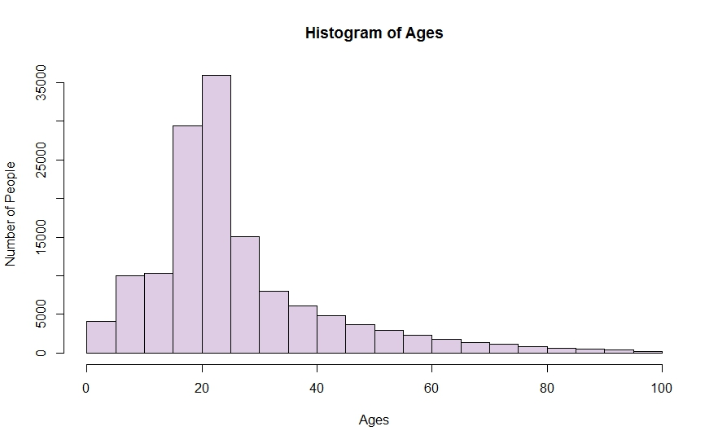
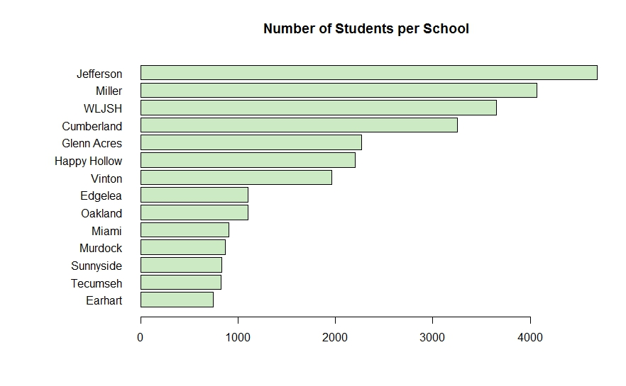
Population Simulation
Statistics on individuals:
- Date of Birth -Income - Sex -Workplace - School

Slide 5
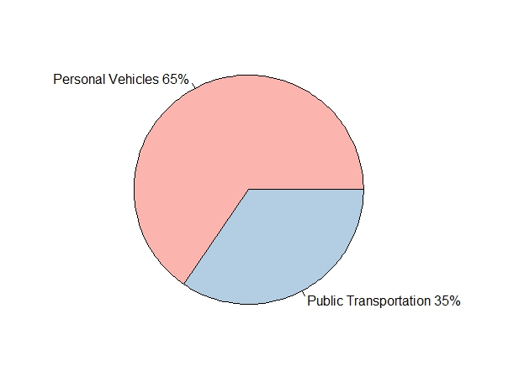
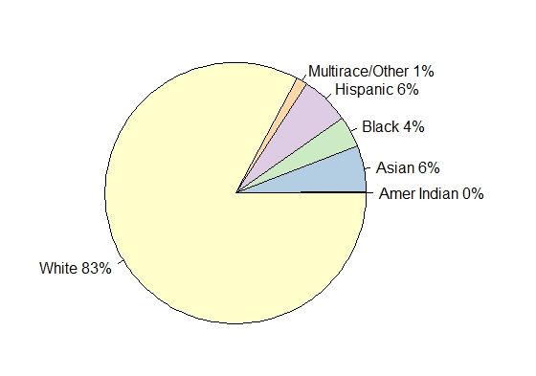
Population Distribution
Statistics on Households:
Race
Public Transport Use

Slide 6
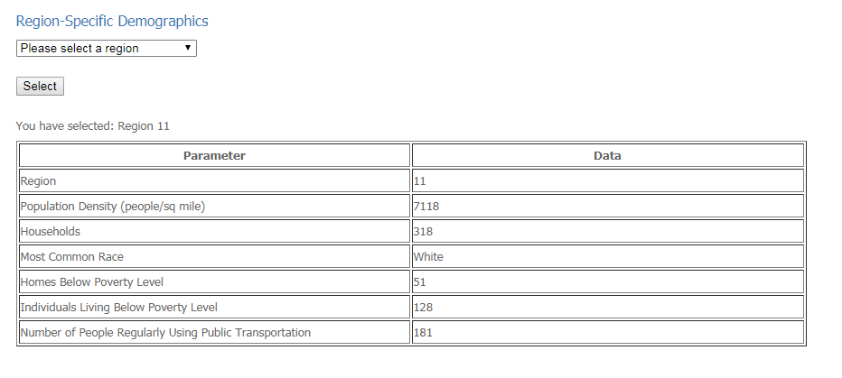
Endless possibilities of customized statistics:
Notes:
Storing the information in a database allows for access to specific information very easily. For example this a screenshot of our website in which the user has asked for information about region 11.

Slide 7
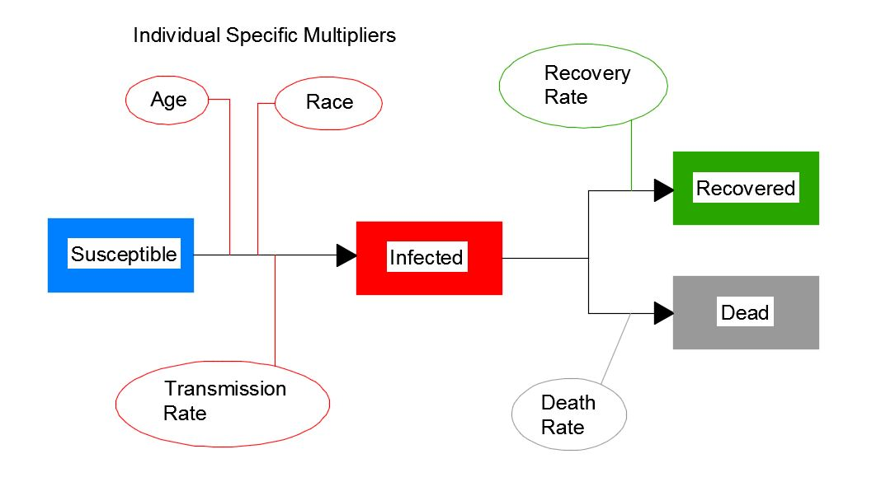
Disease Spread Model
Notes:
The simulation uses a SIR(D) model in which the infected (I) persons are assumed to infect susceptible (S) persons through direct interaction until the infected either recover(R) or die (D) and therefore are no longer susceptible.The probability of infection was claculated basd on amount of time spent interacting with an infected individual as well as induvidual specific factors such as Age and race.

Slide 8
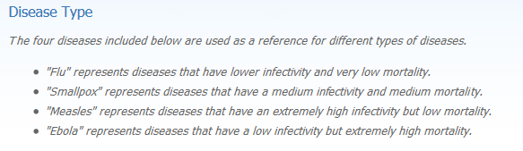
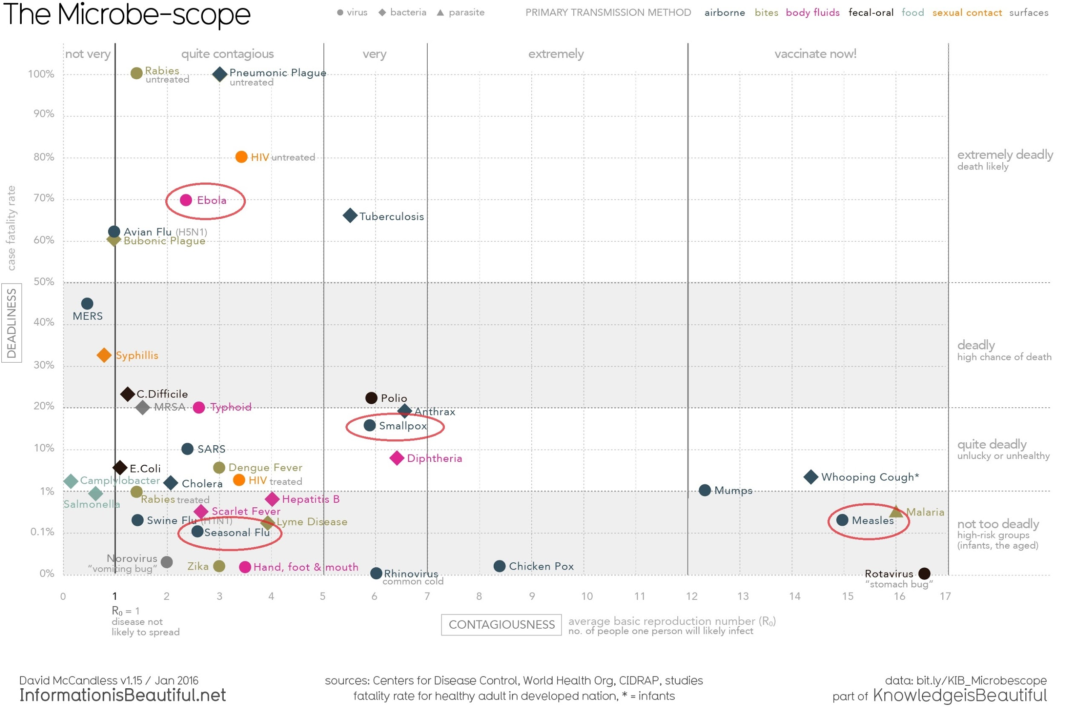
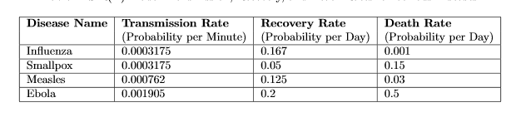
Diseases
Diseases
Deadliness
Contagiousness
Notes:
SIR models may be used for diseases in which individuals infect each other directly (rather than through a disease vector) and when individuals who recover from illness have perfect immunity to the disease thereafter(ref).

Slide 9
Example Simulation: Influenza
36 unique combinations of variables run
100 days per simulation
User inputs:
Type of disease
Number of people initially infected
Percentage of nodes to target (K-nodes)
Notes:
The variable parameters for the simulation were the type of disease, the number of people initially infected and the percentage of people to target with the policy. The simulation was run for 36 combinations of these parameters, with each simulating a period of 100 days.

Slide 10
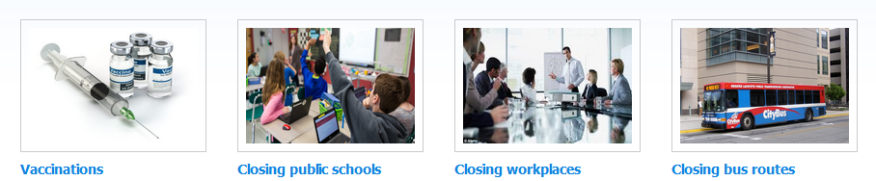
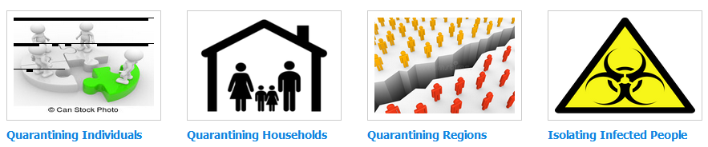
Policies
Notes:
We researched eight different public policies-

Slide 11
Simulation with vaccination implemented
By implementing vaccination policy about 20,000 lives were saved, 40,000 less people infected.

Slide 12
